Slide 1
Itemset Mining

Slide 2
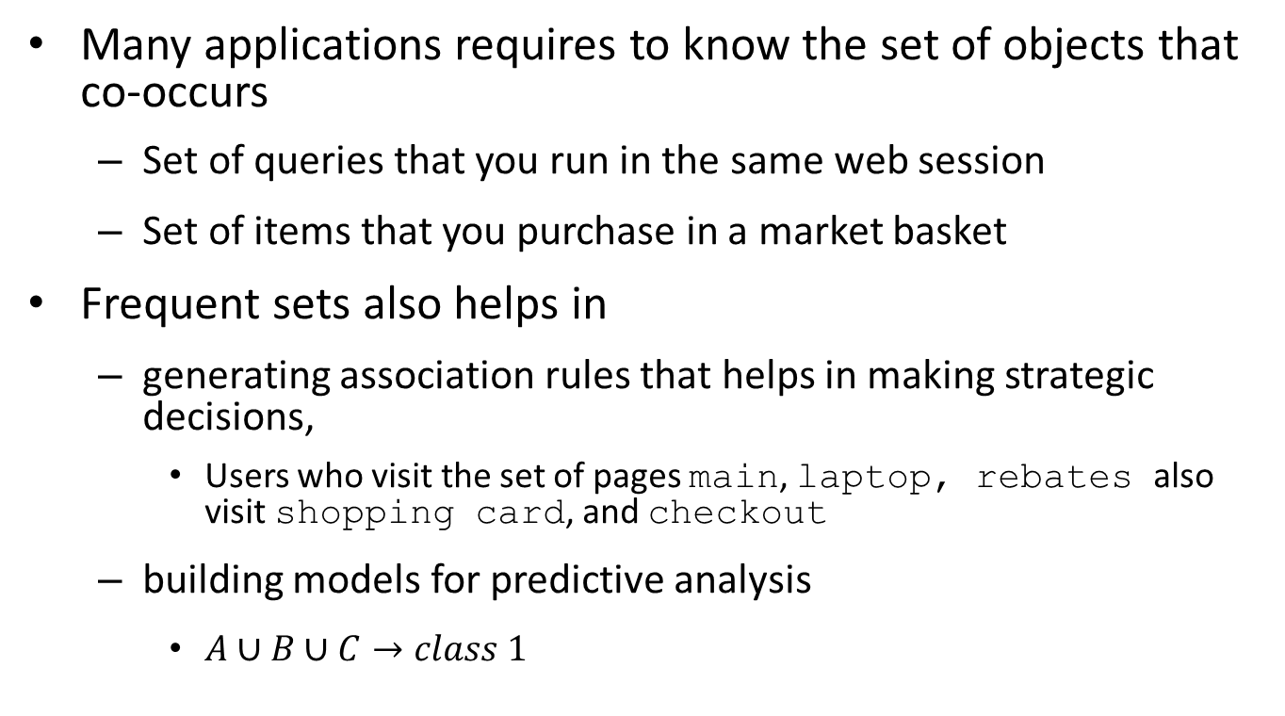
Frequent Itemsets
Many applications requires to know the set of objects that co-occurs
Set of queries that you run in the same web session
Set of items that you purchase in a market basket
Frequent sets also helps in
generating association rules that helps in making strategic decisions,
Users who visit the set of pages main, laptop, rebates also visit shopping card, and checkout
building models for predictive analysis
$A∪B∪C→class 1$

Slide 3
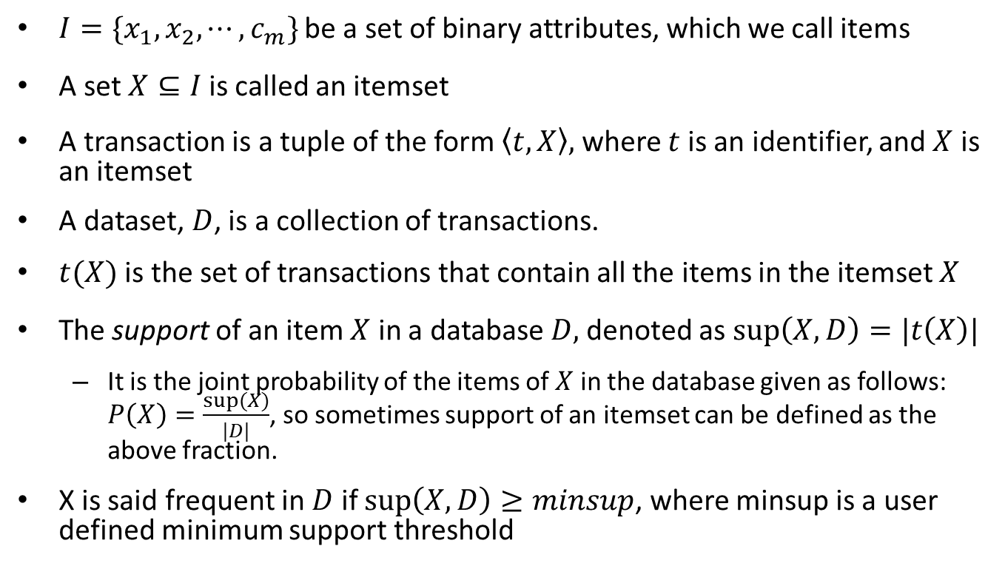
Foundations
$I=\{x_{1}, x_{2}, ⋯, c_{m}\}$ be a set of binary attributes, which we call items
A set $X⊆I$ is called an itemset
A transaction is a tuple of the form $〈t,X〉,$ where $t$is an identifier, and $X$ is an itemset
A dataset, $D$, is a collection of transactions.
$t(X)$ is the set of transactions that contain all the items in the itemset $X$
The support of an item $X$ in a database $D,$denoted as $\sup\left(X, D\right)=|t\left(X\right)|$
It is the joint probability of the items of $X$ in the database given as follows: $P\left(X\right)=\frac{sup⁡(X)}{|D|}$, so sometimes support of an itemset can be defined as the above fraction.
X is said frequent in $D$ if $\sup\left(X, D\right)≥minsup$, where minsup is a user defined minimum support threshold

Slide 4
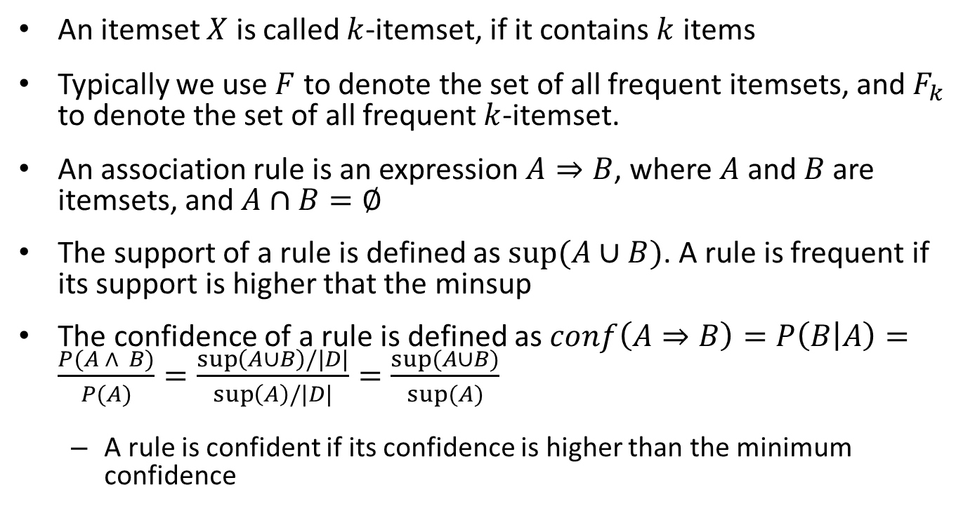
Foundation (cont.)
An itemset $X$ is called $k$-itemset, if it contains $k$ items
Typically we use $F$ to denote the set of all frequent itemsets, and $F_{k}$ to denote the set of all frequent $k$-itemset.
An association rule is an expression $A⇒B$, where $A$ and $B$ are itemsets, and $A∩B=∅$
The support of a rule is defined as $sup⁡(A∪B)$. A rule is frequent if its support is higher that the minsup
The confidence of a rule is defined as $conf\left(A⇒B\right)=P\left(B | A\right)=\frac{P(A ∧ B)}{P(A)}=\frac{\sup\left(A∪B\right)/|D|}{\sup\left(A\right)/|D|}=\frac{sup⁡(A∪B)}{sup⁡(A)}$
A rule is confident if its confidence is higher than the minimum confidence

Slide 5
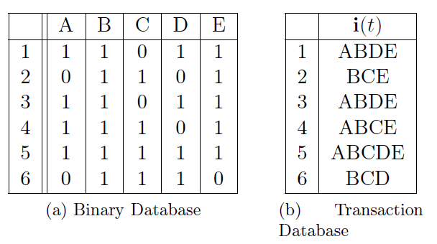
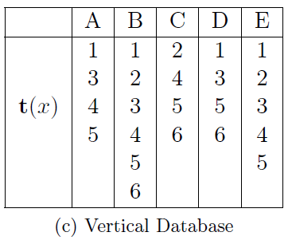
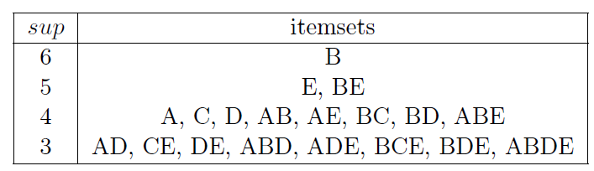
Dataset Example
Frequent itemsets with minsup = 3

Slide 6
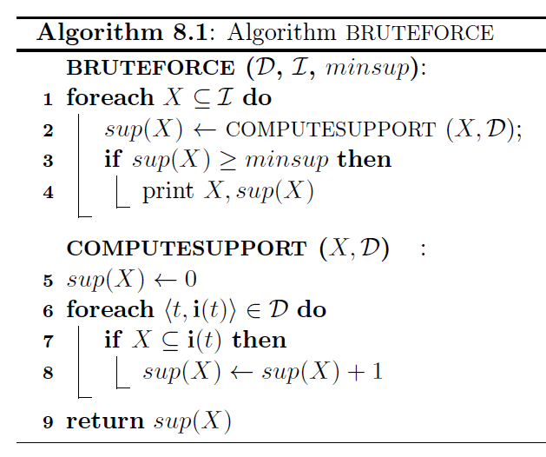
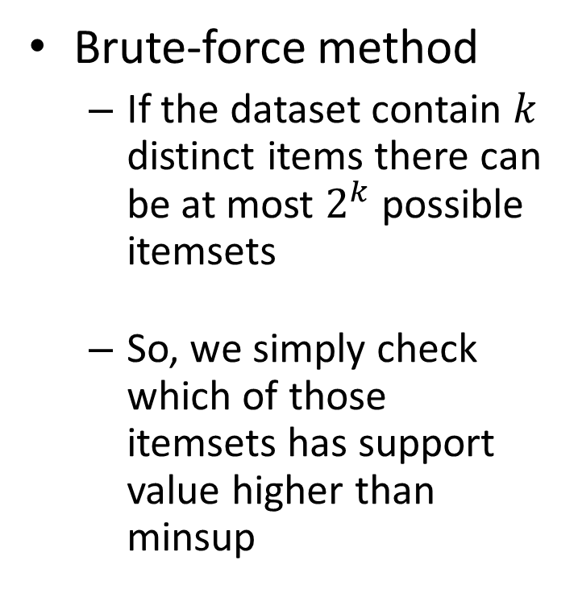
Algorithm for itemset mining
Brute-force method
If the dataset contain $k$ distinct items there can be at most $2^{k}$ possible itemsets
So, we simply check which of those itemsets has support value higher than minsup
Practically infeasible!

Slide 7
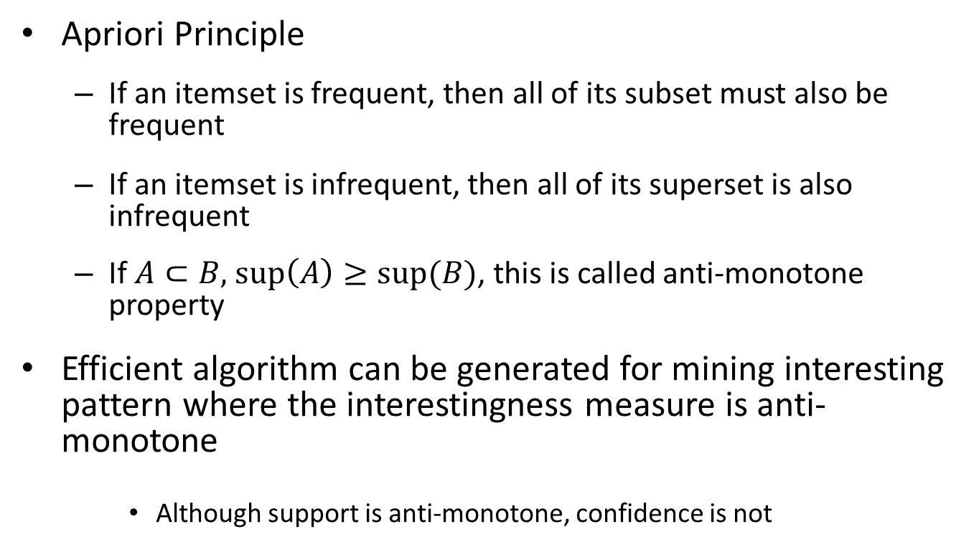
Some important observation
Apriori Principle
If an itemset is frequent, then all of its subset must also be frequent
If an itemset is infrequent, then all of its superset is also infrequent
If $A⊂B,$ $\sup\left(A\right)≥sup⁡(B)$, this is called anti-monotone property
Efficient algorithm can be generated for mining interesting pattern where the interestingness measure is anti-monotone
Although support is anti-monotone, confidence is not

Slide 8
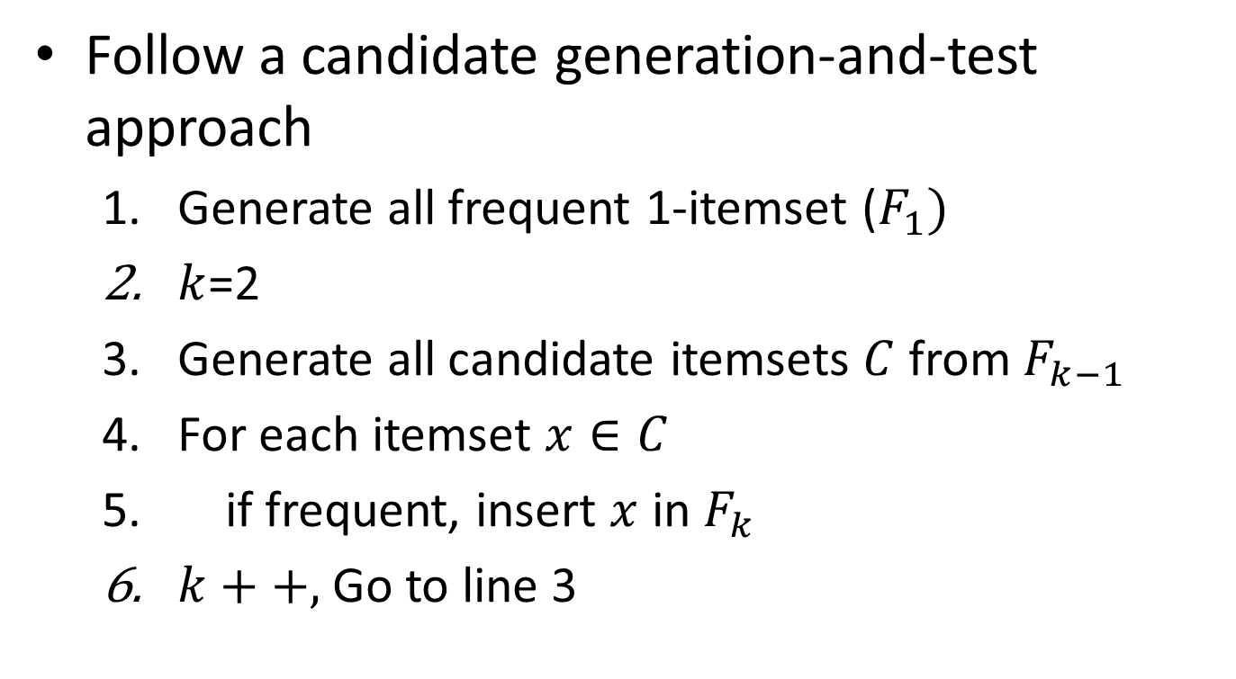
An efficient algorithm
Follow a candidate generation-and-test approach
Generate all frequent 1-itemset ($F_{1})$
$k$=2
Generate all candidate itemsets $C$ from $F_{k−1}$
For each itemset $x∈C$
if frequent, insert $x$ in $F_{k}$
$k++,$Go to line 3

Slide 9
Algorithm (cont.)
Step 3 is called candidate generation, and step 5 is called support counting
Important
Generate all possible candidates (completeness)
Generate each candidate at most once (efficiency)
Generate the candidate in an order that helps efficient support counting (efficiency)

Slide 10
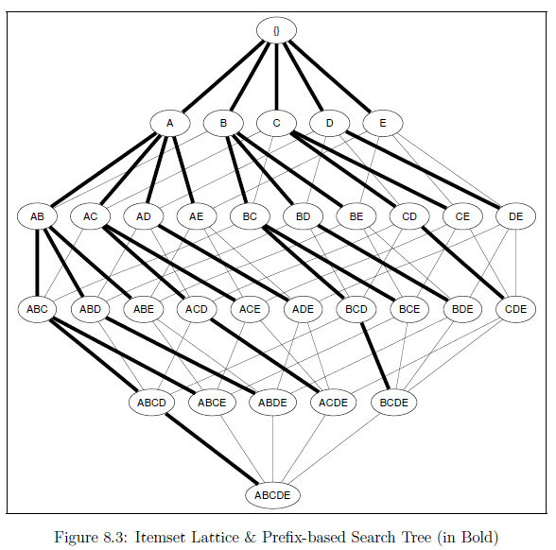
Itemset Lattice
Shows the order in which the candidates should be generated

Slide 11
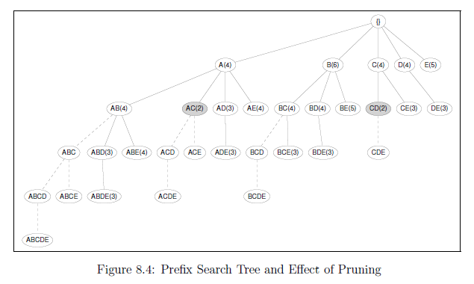
Prefix search tree
Shows how the candidate should be generated exactly once

Slide 12
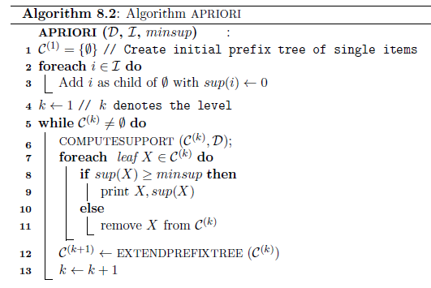
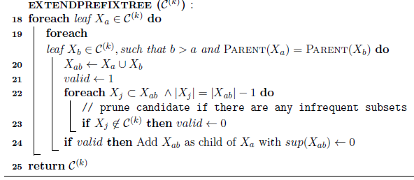
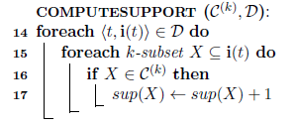
Apriori algorithm

Slide 13
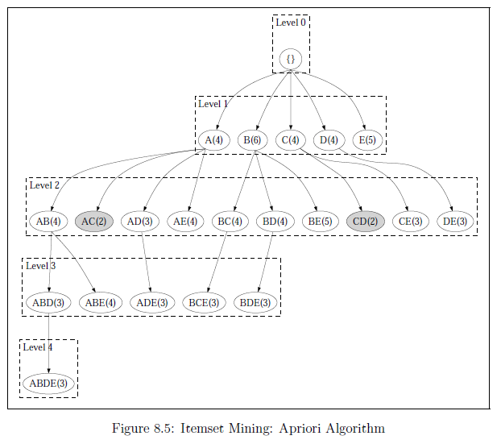
Apriori Algorithm

Slide 14
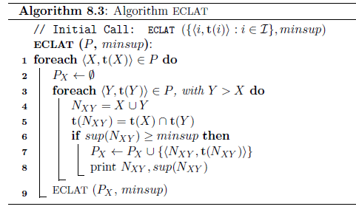
Eclat Algorithm

Slide 15
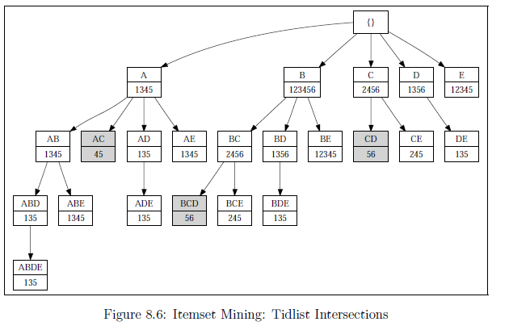
Eclat Example

Slide 16
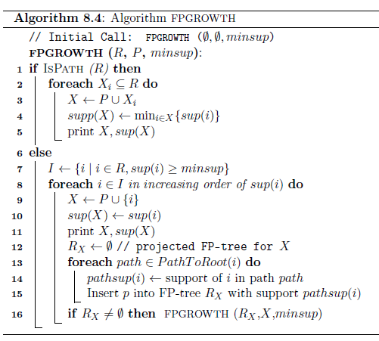
Fp-Growth Algorithm

Slide 17
Fp-Growth example

Slide 18
Projection of Fp-growth algorithm
Projected FP-Tree for the pattern D

Slide 19
Projection (cont.)

Slide 20
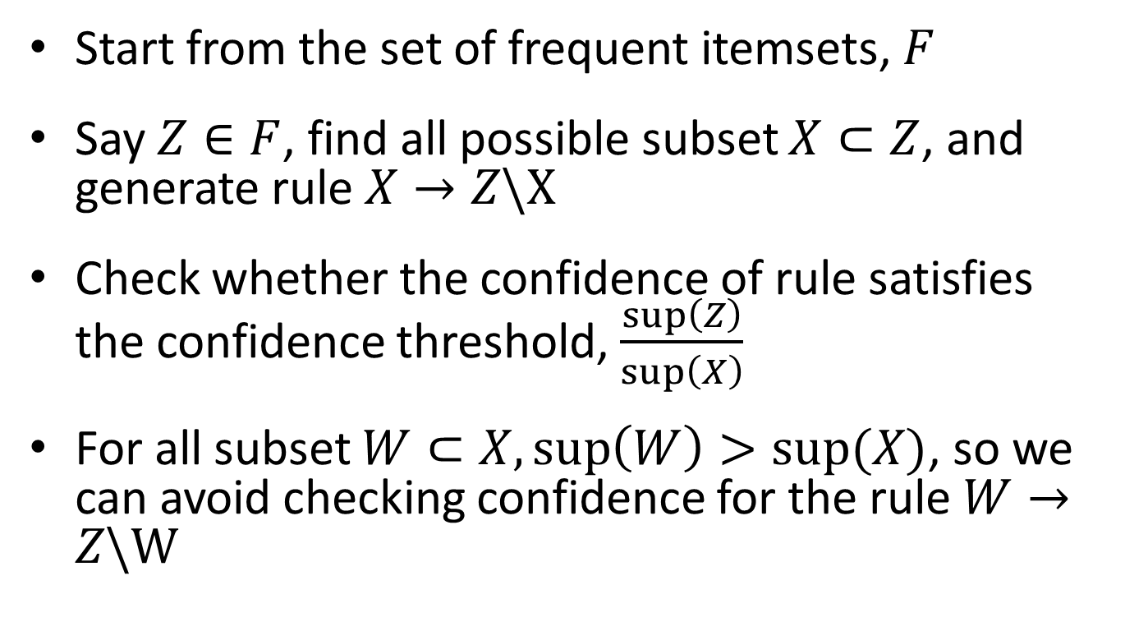
Generating Association rules
Start from the set of frequent itemsets, $F$
Say $Z∈F$, find all possible subset $X⊂Z$, and generate rule $X→Z\backslash X$
Check whether the confidence of rule satisfies the confidence threshold, $\frac{\sup\left(Z\right)}{\sup\left(X\right)}$
For all subset $W⊂X,\sup\left(W\right)>sup⁡(X)$, so we can avoid checking confidence for the rule $W→Z\backslash W$

Slide 21
Pseudocode

